Slide 1
HP Software Universe
December 9-11, 2008 I Vienna, Austria
HP overview
Francesco Serafini Managing Director HP EMEA and
Senior Vice President Technology Solutions Group

Slide 2
Q4 & FY08 financial highlights
Q4 FY08
FY08
Net revenue of $33.6B, growth of $5.3B, up 19% Y/Y or 16% in constant currency
Non-GAAP diluted EPS of $1.03, up 20% from $0.86 in Q4 FY07
GAAP diluted EPS of $0.84, up 4% from $0.81 in Q4 FY07
Cash flow from operations of $3.3B
$1.9B in share repurchases, and $196M in dividends
Net revenue of $118.4B, growth of $14.1B, up 13% Y/Y or 8% in constant currency
Non-GAAP diluted EPS of $3.62, up 24% from $2.93 in FY07
GAAP diluted EPS of $3.25, up 21% from $2.68 in FY07
Cash flow from operations of $14.6B
$9.6B in share repurchases, and $796M in dividends
Consolidated 85 loosely connected data centres to three paired ones
Reduced 5,000 applications to 1,500
Moved from ~ 23000 servers to 14000
Replaced 750+ datamarts with one data warehouse
Saved 65% in power and cooling costs

Slide 3
HP in EMEA
#1 IT vendor in EMEA
42% of worldwide revenue
50 subsidiaries
200+ sites
5 R&D centers
270 distributors
5,000 Preferred Partner resellers
120,000 other active resellers

Slide 4
Focused, multi-year M&A strategy
Operating leverage expansion
Acquisition
Execution
Market leadership & profitability
Services
EDS
Scale and expand services
Leverage go-to-market
Drive efficiency
Infrastructure and application outsourcing, Workplace services, Datacenter services, Support/training services
Software
Mercury, Opsware, Peregrine
Expand portfolio
Double R&D
Optimize go-to-market
Distributed management software, SOA governance, automated software, quality
2002 2008
Hardware
Compaq
Scale
Focused R&D for growth
Optimize go-to-market
Drive efficiency
X86, Blades, Unix, Linux, Windows, Disk storage

Slide 5
…we’re ready to seize the opportunity

Slide 6
HP Software Universe
December 9-11, 2008 I Vienna, Austria
Steen Lomholt-Thomsen
VP & GM, HP Software & Solutions, EMEA

Slide 7
What the business demands of IT
Better business agility
Risk mitigation
More for less
Innovation and insight

Slide 8
Investing for success
EDS September 2008
Over $400 million in organic R&D (last 12 months)
Strategic mergers and acquisitions
Tower Software May 2008
Opsware September 2007
SPI Dynamics August 2007
C&I November 2008
Bristol Technologies February 2007
Neoview November 2007
Mercury November 2006
Peregrine December 2005
Storage Essentials November 2007
Knightsbridge December 2006
TTP June2006
2006
2007
2008
Product Solution
Notes:
8
8

Slide 9
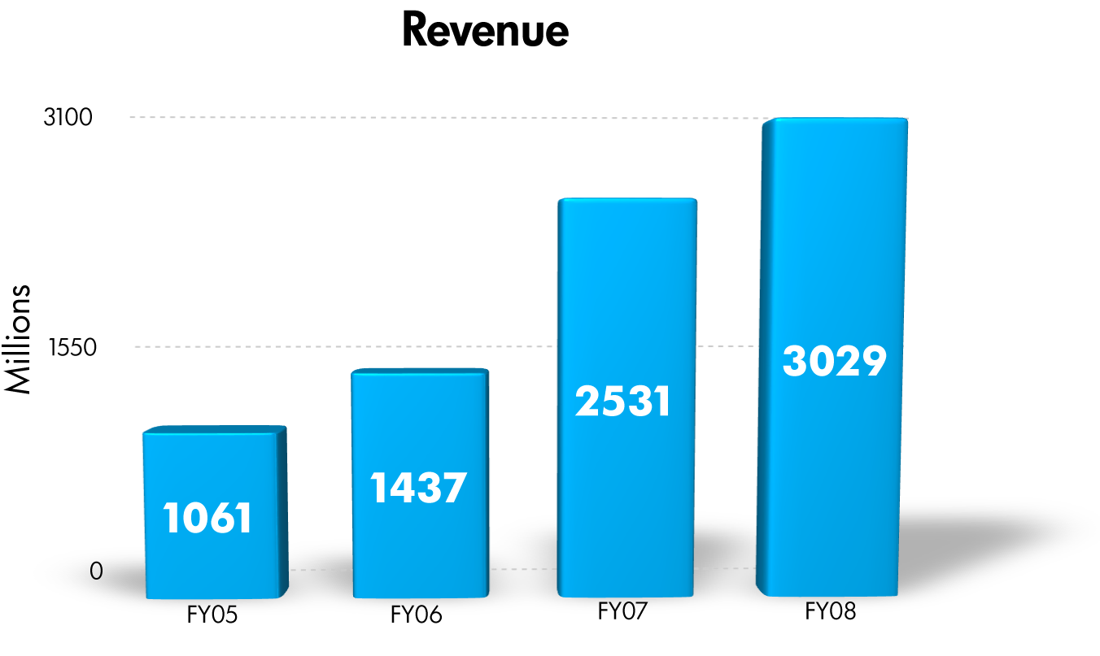
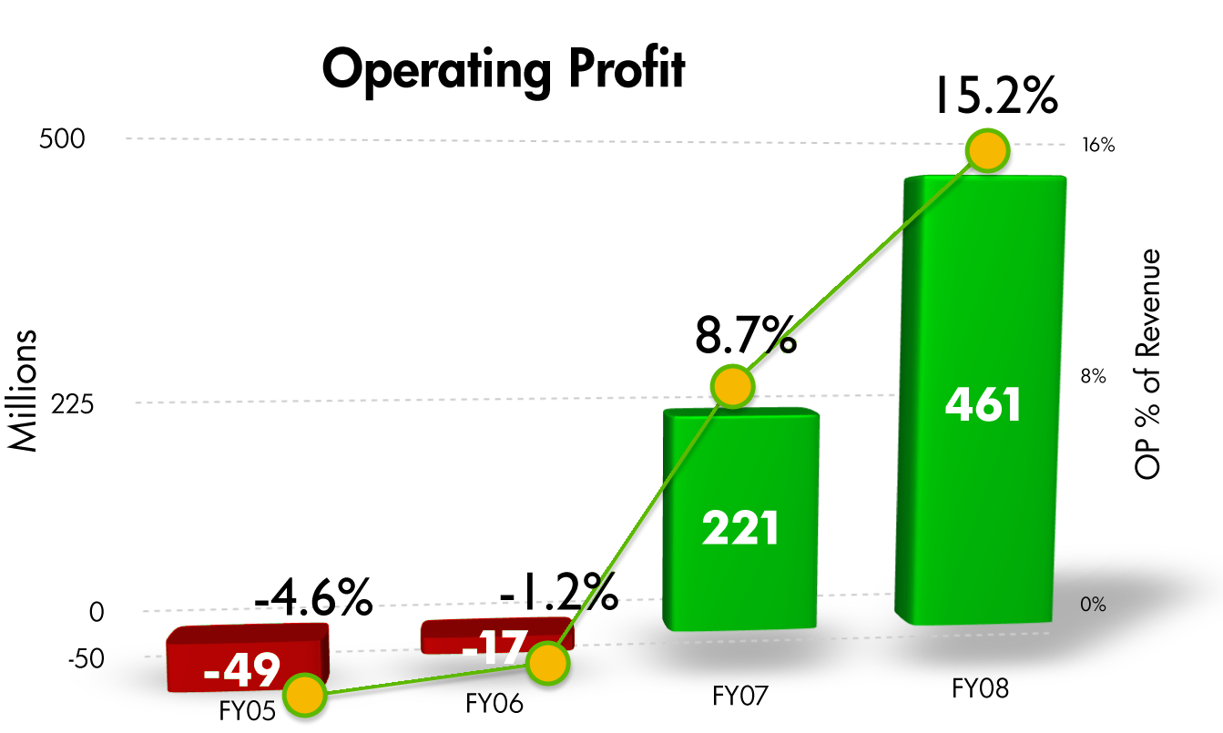
Strong Performance
FY08 Revenue Highlights
$3.029 billion, up 20% YoY, revenue
tripling over four years
BTO/IT Mgmt - $2.497 billion, up 25% YoY
Information Management up 35% (23% organic)
FY08 Operating Profits
$461 million,15.2% of revenues, up 6.5 ppt YoY
Profitability more than quadrupled in 4 years
BTO/IT Mgmt – operating profit of 30.0%, up 2.7ppt YoY
Information Management – operating profit of 11.6% of revenues, up 9% ppt YoY
OpenCall - 1.4%, down 3.1ppt YoY
Notes:
9

Slide 10
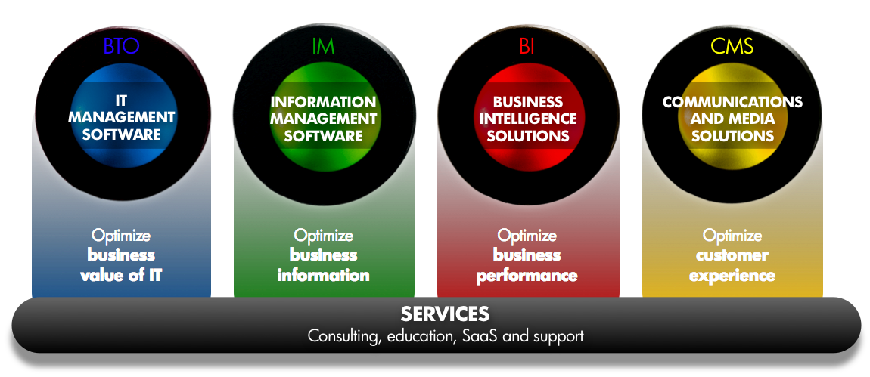
Strategically relevant for our customers
Our management and industry solutions optimize business outcomes and extract more value from your investments in people, applications, infrastructure, networks and information

Slide 11
Crisis creates opportunity
1
Those who are prepared, will succeed
2
It’s about attitude and execution
3
Success comes from strong customer focus
…and we’re ready to seize the opportunity

Slide 12
HP Software Universe
December 9-11, 2008 I Vienna, Austria
The Smart CIO:
Responding decisively to changing business cycles

Slide 13
Announcement overview
New HP Software and Zero Percent Lease Financing Help CIOs Respond to Tough Economy
New HP Business Technology Optimization (BTO) software solutions help chief information officers (CIO) quickly adapt IT investments to drive down costs and strengthen competitive advantage
Zero percent lease financing for qualifying HP Software & Solutions customers
New Products and Integrations
HP Quality Center 10 software
New Integrations of HP BTO software with HP Universal Configuration Management Database (UCMDB) 8
Additional software products delivered through HP Software-as-a-Service (SaaS)

Slide 14
The cyclical reality of the business environment
The Technology Bubble
Financial & Credit Crisis
Collapse of the Bubble
Expansion and growth
Innovate
Rationalize
Modernize
?
Changing business cycles accelerate the need for more alignment and efficiencies in IT

Slide 15
Smart CIO’s— Turn adversity into advantage
Gain a sustainable advantage by accelerating technology modernization while cutting costs
Application modernization
IT operations modernization
Web 2.0
Agile development
Rapid upgrades –SAP, Oracle, Vista
SOA and composite applications
SaaS, Cloud
Service-orientated delivery
Automation
Virtualization
Proprietary to standard
Infrastructure refresh

Slide 16
Modernization is imperative
“As the cost of capital continues to rise under challenging economic conditions, organizations will face procurement challenges as they review expenditures with tightening scrutiny. CIO’s who seek alternate funding models to enable long-term innovation while controlling costs, conserving capital and managing risk will put their firms in a much better position to emerge from this tough economic cycle than their competition.”
Joe Pucciarelli, Program Director, Technology Financing & Executive Strategies, IDC
16
12/10/2008
HP Confidential - Don't Copy or Distribute

Slide 17
Accelerating modernization is difficult without a workable plan
Difficult to determine
Is demand aligned with business priorities?
Have requirements changed?
REQUIREMENTS
Difficult to determine
What are my projects, people, demand?
Are services shared, duplicated, idle?
CURRENT STATE
Difficult to assess
Should I reduce, delay or continue investments?
What if I change or retire infrastructure?
IMPACT
Difficult to create
How do I eliminate duplicate tools?
How do I implement repeatable, automated processes?
EFFICIENCY
17
12/10/2008
HP Confidential - Don't Copy or Distribute

Slide 18
HP advocates three essential actions
1
Take control of IT spending and prioritize investments based on business value
2
Centralize service delivery functions to eliminate redundancy and respond flexibly to new business needs
3
Standardize through best-practices and automation to reduce risk and lower cost
Deliver better business outcomes despite tighter budgets

Slide 19
Business Technology Optimization provides a proven framework
Business outcomes
Business outcomes
Accountable
Financial control, SLAs, governance
1
1
Improve business and IT alignment
STRATEGY
APPLICATIONS
OPERATIONS
Repeatable
Automation, policies, best practices
2
2
2
2
Automate, standardize and integrate key functions within IT domains
3
3
Automate and integrate key processes across the IT value chain with a lifecycle approach
19
10 December 2008
Notes:
19

Slide 20
Driving efficiency with HP Business Technology Optimization solutions
STRATEGY
APPLICATIONS
OPERATIONS
7.8% Saved from annual IT budget by avoiding non-strategic projects
- Gantry Group study
$1.2M Eliminated per year in recurring audit costs
- Constellation Energy
95% Compliance for all new services
- UK mobile communications retailer
75% Reduction in performance validation cycle
- Rabobank
95% Decrease in audit samples
- Constellation Energy
1 hr Time to which security validation cycle was reduced from one week
- Mobile data specialist
88% Reduced costs for processing catalog requests by 88%
- KBC
100% Resolution of incidents on time, with average fix time of 7 minutes
- European electronic payments
95% Successful change implementations
- Global asset management firm
Better management of cost, risk, and change across strategy, applications and operations

Slide 21
Introducing new HP Business Technology Optimization (BTO) solutions
Application Modernization
Operations Modernization
HP Quality Center 10
HP Universal Configuration Management Database 8
QC (Starter, Enterprise, Premier)
Requirements Management
QuickTest Professional
Business Process Testing
Refresh of all related modules and add-ons
New integrated releases
HP Business Availability Center 8
HP Operations Manager i Series
HP Network Node Manager i Series Advanced
HP Network Automation 7.5
HP Service Manager 7.1
Accelerate and realize the benefits of application modernization
Gain a 360-degree view of business services for unprecedented automation and operational predictability

Slide 22
TAKING CONTROL OF APPLICATIONS

Slide 23
HP Quality Center 10—the foundation for managing the application lifecycle
NEW
Business Outcomes
Robust requirements management–align activities with business priorities
Centers of excellence centralize functions & release trains–to lower costs
Standardized processes from planning to production–lowers cost and risk
STRATEGY
APPLICATIONS
OPERATIONS
QUALITY CENTER 10
Business-centric
Quality-driven
Demand, project and resource management through integration with PPM Center
Integrated requirements management
(including versioning and baselining)
Sharing and re-use of all requirements, tests, and defects
Enforcement of common processes and KPIs across all projects
Support for the latest application environments (e.g., AJAX, Flex)
Further reduce expenditure with HP Software-as-a-Service
Notes:
23

Slide 24
Principal Financial Group
HP Quality Center simultaneously drives costs out, lowers risk and improves quality for your critical business applications
"With quality assurance teams servicing over a dozen business units, each with thousands of users, HP Quality Center is helping us standardize processes, solutions and infrastructure as we move to a Quality Center of Excellence. This increases collaboration between groups, enables flexibility to move personnel between projects, provides management level visibility across application releases, and helps us save on hardware and software deployment across the enterprise.”
- Mark Ford Senior IT System Analyst, Principal Financial Group

Slide 25
TAKING CONTROL OF OPERATIONS

Slide 26
UCMDB 8—the foundation for deeper automation & operational predictability
NEW
Business Outcomes
Prioritizes incidents to speed problem resolution and reduce IT costs
Centralizes information and service delivery functions to reduce cost and risk
Accelerates adoption of best practices and further automate
STRATEGY
APPLICATIONS
OPERATIONS
Core of the federated HP Configuration Management System (CMS) solution
Common, 360-degree view of services
Automated discovery of all infrastructure and applications
Single source of truth for all tools
Direct root cause analysis
Integrations for predictive problem management and rapid resolution
Automated
release management
Health
monitoring
HP UCMDB 8 (CMS)
HP BAC 8, OMi, NNMi
HP SM 7.1
Change management
Incident and problem management
HP NA 7.5
HP SM 7.1

Slide 27
KBC Group
Leading banking and insurance services provider
“HP’s IT Service Management solution helps KBC resolve more than 90% of incidents before specified deadlines. The benefit to our customers is optimal availability of banking services.”
Lieven Schouwaerts, KBC Business Analyst
Objective
Approach
Results
Bank systems consolidation following merger of three financial institutions
Disconnected management tools and processes
Process gaps and lack of visibility
Managing operational risk
Reporting against business controls relating to budgets and performance
Operations
HP Universal CMDB
HP Business Availability Center
HP Service Management Center
Reduced costs for processing catalog requests by 88%
Saved 8,000 hours per year through automation
Minimized operating risk through automated controls
Demonstrated regulatory compliance
Achieved 98% availability of ATMs and near-perfect bank system availability

Slide 28
ACCELERATE TIME TO VALUE

Slide 29
Accelerate time to value
HP flexible, packaged services offerings
Software as a Service
Professional Services
EDS Offerings
Provide BTO software on demand backed by 24x7 support
Accelerate deployment and time to value
Align service delivery with ongoing mentoring and best practices
No significant start up cost or training
Allows CIOs to quickly adapt to change through:
BTO Software Quickstarts
Preconfigured HP Software Blueprints
Education services for quick knowledge transfer
EDS Testing and Quality Assurance Services
Maximize the value of HP software solutions more quickly, more fully, with less burden on your resources and more knowledge transfer to your staff

Slide 30
Turn adversity into advantage
HP Quality Center 10
HP Universal Configuration Management Database 8
Gain a 360-degree view of business services for unprecedented automation and operational predictability
Accelerate and realize the benefits of application modernization
Prioritize, centralize, and standardize to deliver better business outcomes

