Slide 1












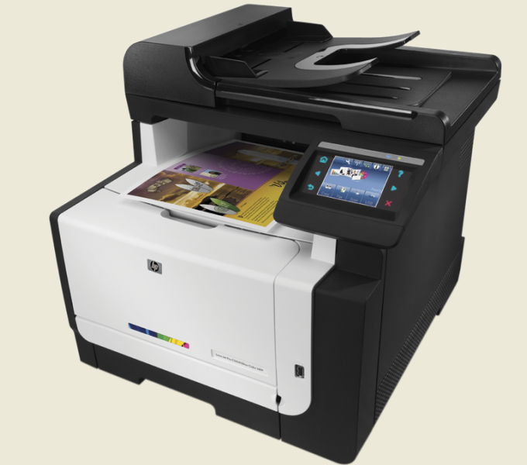










APPS
FLIPBOOK
Notes:
Front Cover

Slide 2
NEWS

Slide 3

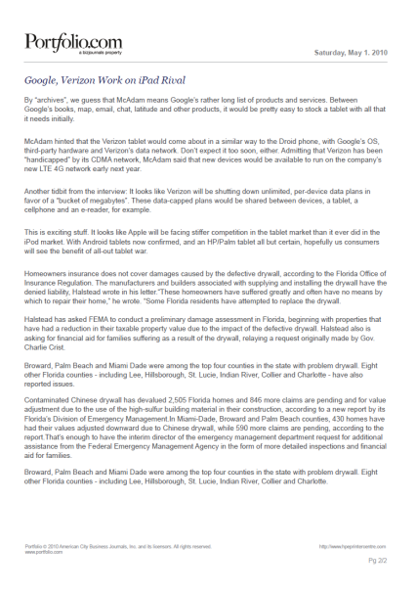
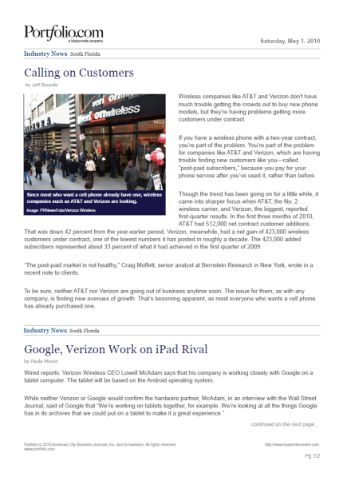
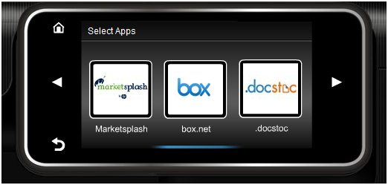
Portfolio.com
SHORT APP DESCRIPTION
NEWS CATEGORIES & CONTENT
Grab the latest industry news articles from Portfolio.com – it’s as easy as tap and print.
CATEGORY
Accounting and Consulting
Insurance
LONG APP DESCRIPTION
Agriculture
Legal Services
Hand-pick news items that pertain just to you. Portfolio.com offers quick delivery of news, stock information, in-depth interviews and more – all at the touch of a finger.
Banking and Financial Services
Logistics and Transportation
Economic Snapshot and Bankruptcies
Manufacturing
Real Estate
Media and Marketing
USER INTERFACE
COUNTRIES
Education
Retailing and Restaurants
Energy, the Environment and Green
Sports
Select Apps
Health Care
Technology
Human Resources
Travel Industry
Portfolio.com
CONTENT
Language(s): English
Each Category:
All newly updated articles in the last 24 hours

Slide 4

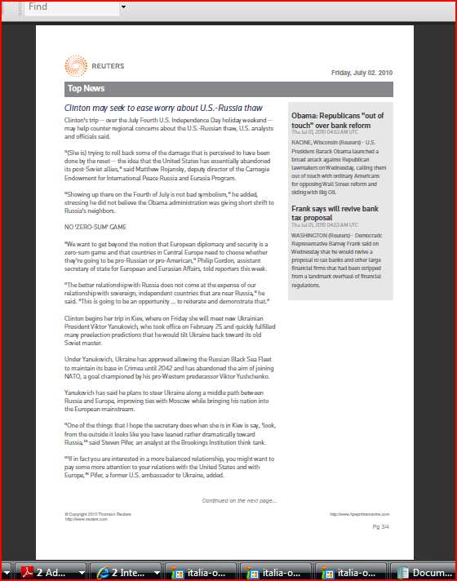
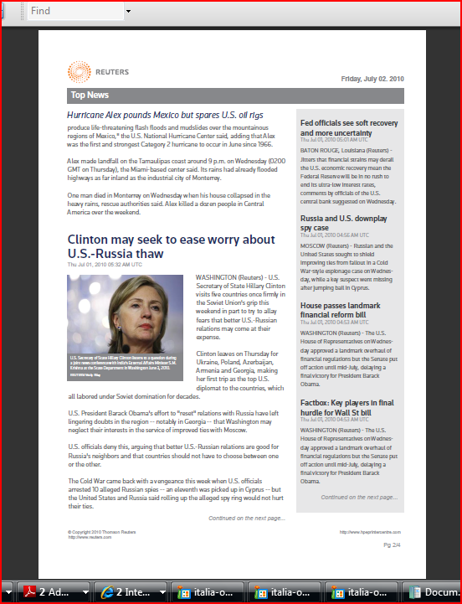
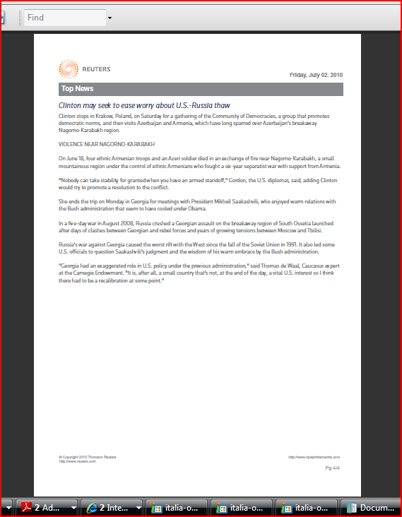
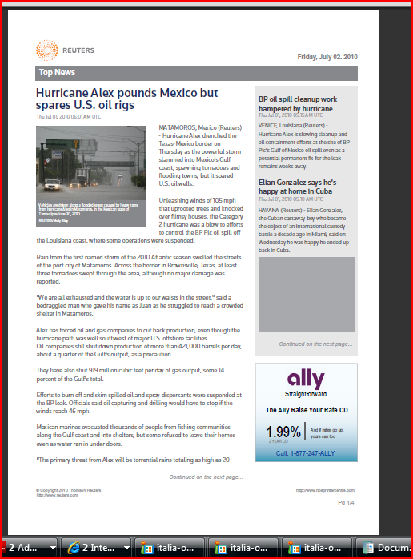





Reuters
SHORT APP DESCRIPTION
NEWS CATEGORIES & CONTENT
Get real-time news offered in several categories to print and read on the go.
US
GBR, DEU, ESP, ITA & FRA
CATEGORY
Overview*
World News
LONG APP DESCRIPTION
Top News
Health
Business
Politics
Reuters provides trusted, professional news in real time. Select the categories important to you, and print to read on the go.
Sports
Internet
Entertainment
Science
Oddly Enough
Lifestyle
USER INTERFACE
COUNTRIES
Domestic
Markets
Technology
Companies
Select Apps
CONTENT
*
* Overview:
2 summaries from each category
News - USA
News - ITA
* Additional Country Apps for Reuters:
News – FRA News - ESP
News – DEU News - GBR
Each additional Category:
2 full stories and 8 summaries
Language(s): EFIGS

Slide 5
Reuters, continued
US
GBR, DEU, ESP, ITA & FRA
NEWS CATEGORIES & CONTENT
NEWS CONTENT CATEGORIES ACCORDING TO REGIONS
CATEGORY
For each region, there will be an individual App developed. Not all contents are available in the regions. Please refer to the table below.
Overview*
World News
Overview
Oddly Enough
Domestic
Technology
World News
Health
Politics
Internet
Science
Lifestyle
Markets
Top News
Companies
Business
Sports
Top News
Health
Entertainment
Business
Politics
Region
Language
App Name
Sports
Internet
US
English
Reuters US
x
x
x
x
x
x
x
x
x
x
x
x
x
x
x
x
Entertainment
Science
France
French
Reuters France
x
x
x
x
x
x
x
x
Oddly Enough
Lifestyle
Germany
German
Reuters Germany
x
x
x
x
x
x
Domestic
Markets
Italy
Italian
Reuters Italy
x
x
x
x
x
Technology
Companies
Spain
Spanish
Reuters Spain
x
x
x
x
x
x
UK
English
Reuters UK
x
x
x
x
x
x
x
x
x
x
x
x
x
x
x
CONTENT
* Overview:
2 summaries from each category
Each additional Category:
2 full stories and 8 summaries

Slide 6

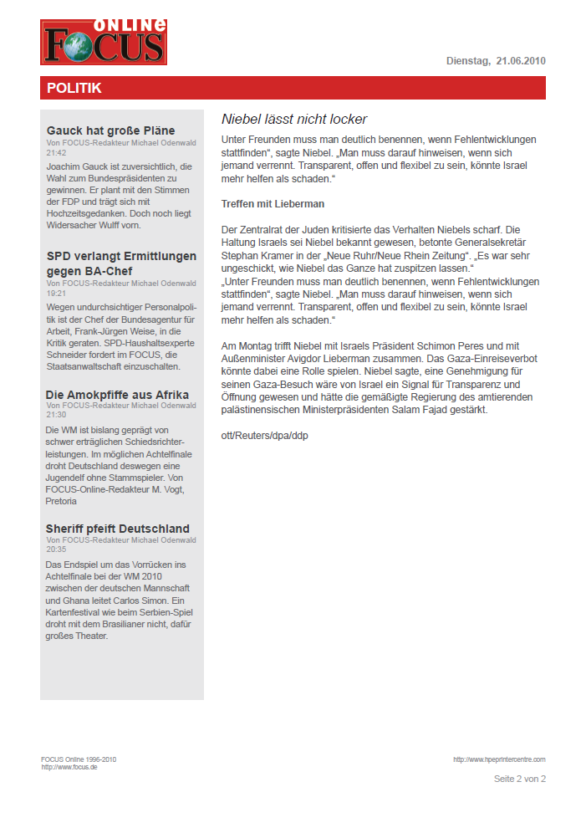
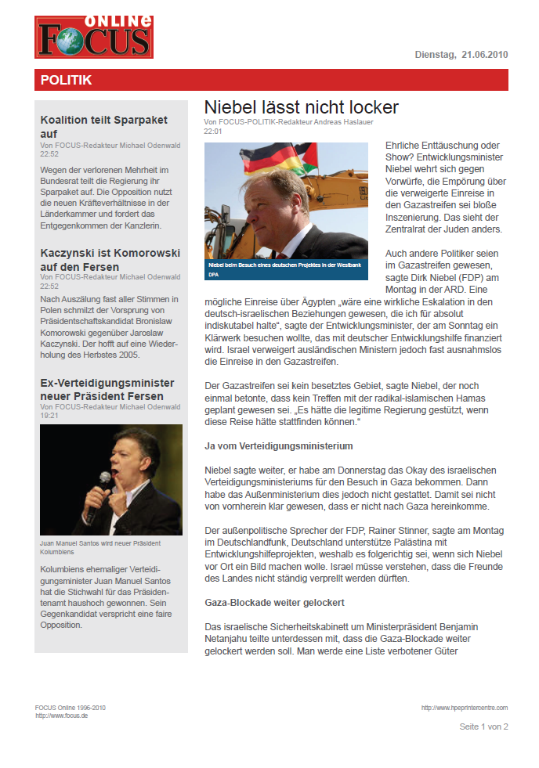
FOCUS
SHORT APP DESCRIPTION
NEWS CATEGORIES & CONTENT
Print articles and analysis in a snap to keep close to vital industry information – banking, healthcare and more.
CATEGORY
Politik
(Politics)
Digital
(Digital Industry)
LONG APP DESCRIPTION
FOCUS Online delivers fast access to news and analysis formatted for print from the industries that affect you most – banking, healthcare, energy, travel, insurance and more. Simply use the touchscreen to get the prints you want.
Wirtschaft
(Economy)
Karriere
(Career)
Finanzen
(Finance)
Immobilien
(Real Estate)
USER INTERFACE
COUNTRIES
CONTENT
Select Apps
Each Category:
1 full story and maximum
of 25 news teasers
News
Language(s): German

Slide 7

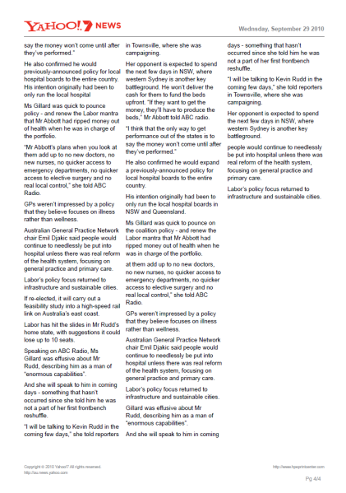
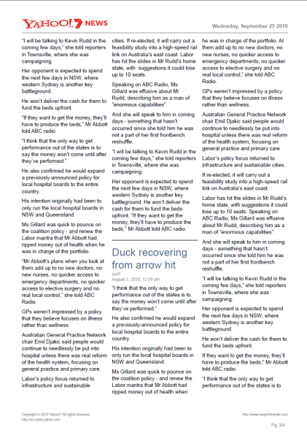
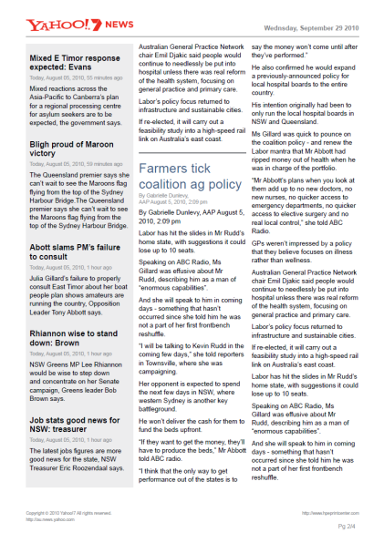
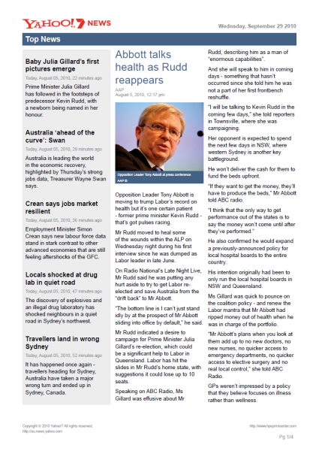
Yahoo!7
SHORT APP DESCRIPTION
NEWS CATEGORIES & CONTENT
Connect to Yahoo!7 to print news – world and national headlines, sports and more – as quick and easy as a touch.
CATEGORY
Top Stories
LONG APP DESCRIPTION
World
With fast access to Yahoo!7 directly from your printer, you can get the information you want without having to use a PC – world and national news, headlines, sports and more.
Business
Sport
USER INTERFACE
COUNTRIES
Entertainment
Select Apps
CONTENT
Each Category:
3 full news articles + 7 short summaries
News
Language(s): English

Slide 8

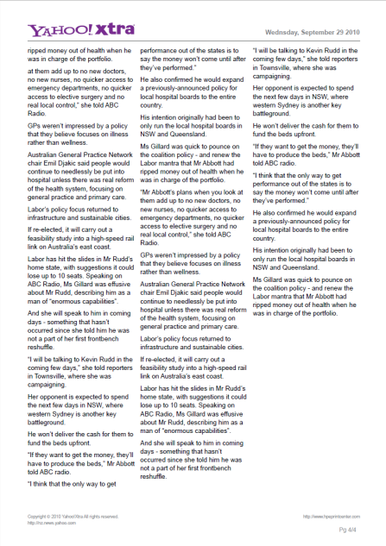
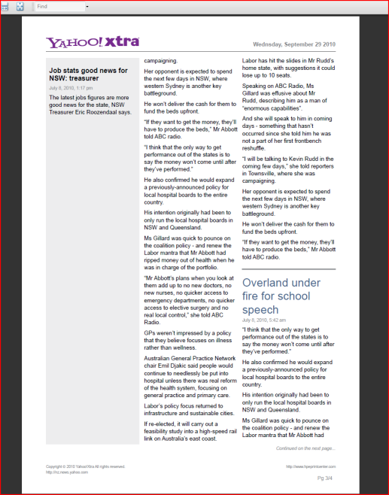
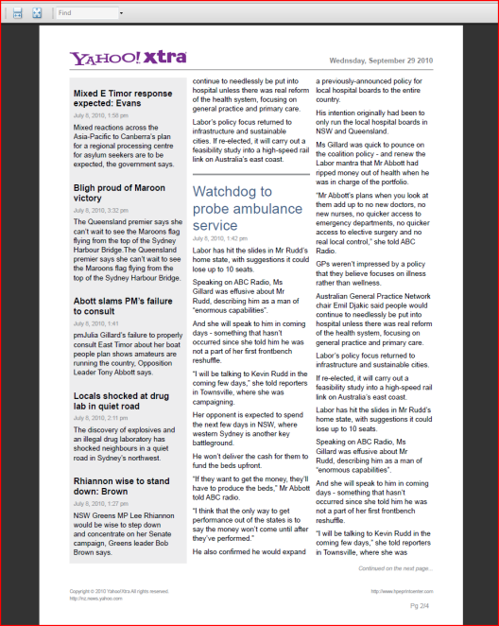
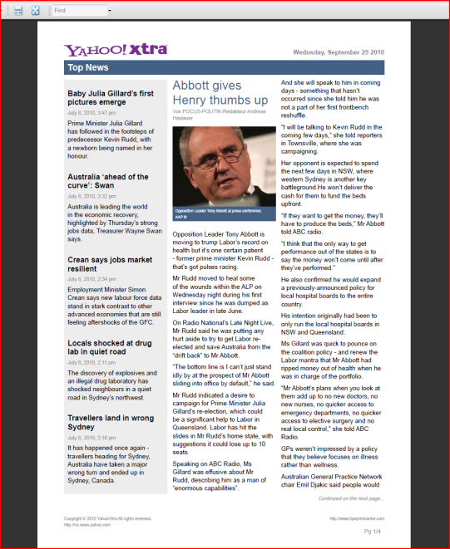
Yahoo!Xtra
SHORT APP DESCRIPTION
NEWS CATEGORIES & CONTENT
Stay up-to-date on news with world and local headlines from Yahoo!Xtra – it’s as easy and print, grab and go.
CATEGORY
Top Stories
LONG APP DESCRIPTION
World
Keep track of worldwide and national news, from fashion to business news. Simply connect to Yahoo!Xtra from your printer’s touchscreen and easily print the news article you want.
Business
Sport
USER INTERFACE
COUNTRIES
Entertainment
Select Apps
CONTENT
Each Category:
3 full news articles + 7 short summaries
News
Language(s): English

Slide 9

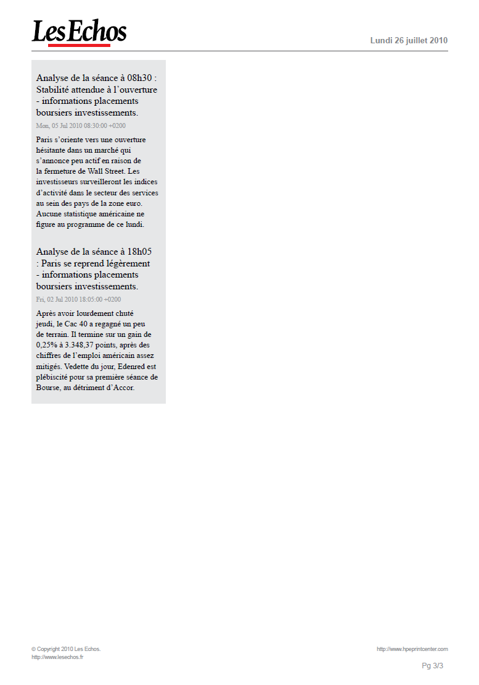
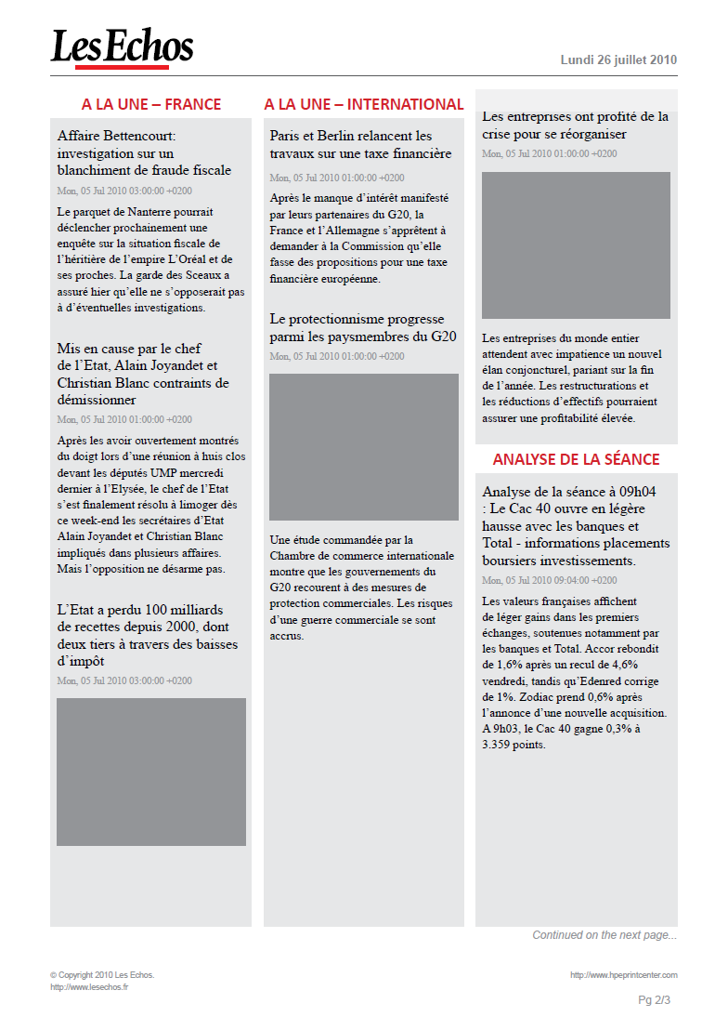
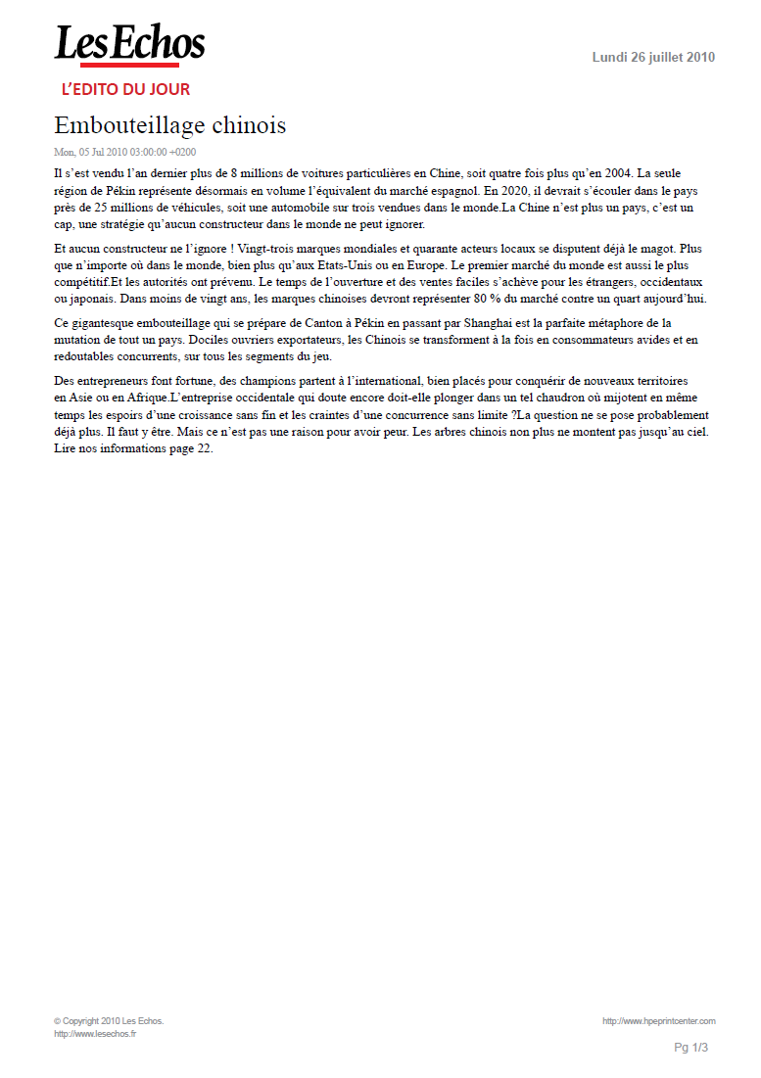
Les Echos
SHORT APP DESCRIPTION
NEWS CATEOGRIES & CONTENT
Quickly connect to Les Echos. Print financial industry news and analysis directly from the touchscreen.
CATEGORY
OUTPUT FORMAT
LONG APP DESCRIPTION
L’édito du jour
Full story
Through Les Echos, you can tap into the latest financial industry news and analysis. Stay connected to essential financial information, and use the touchscreen to quickly and easily print articles.
Three most recent headlines, subtitles and one-sentence summary
A la une - France
A la une - International
USER INTERFACE
COUNTRIES
Analyse de la séance
Select Apps
App Les Echos offers its free contents to all users. All contents are mandatory to print in one package. Users have no selection choice.
News
Language(s): French

Slide 10

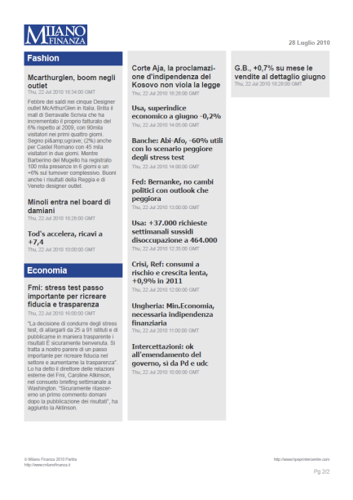
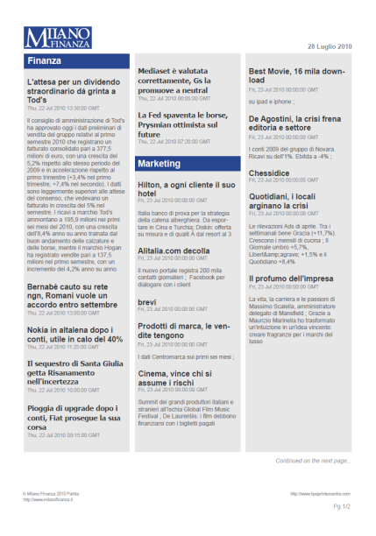
Milano Finanza
SHORT APP DESCRIPTION
NEWS CATEGORIES & CONTENT
Improve the way you connect to financial and business news, with fast access to printable Milano Finanza stories.
*
CATEGORY
CONTENT
MF News (Free)
Free 4 page PDF
(Monday – Friday)
LONG APP DESCRIPTION
Milano Finanza makes it easy to quickly access and print financial news and analysis. Simply use the touchscreen to get vital information related to several professional industries – finance, law, economics and more.
MF Mercati Finanzaiari
(Premium)
30-40 page
PDF Package
(Tuesday – Friday)
USER INTERFACE
COUNTRIES
Milano Finanza
(Premium)
30-40 page
PDF Package
(Saturday)
Select Apps
App Milano Finanza offers its premium full content to users with active Milano Finanza subscriptions and free contents to all users.
News
Language(s): Italian
* Output sample is not a finalized version

Slide 11

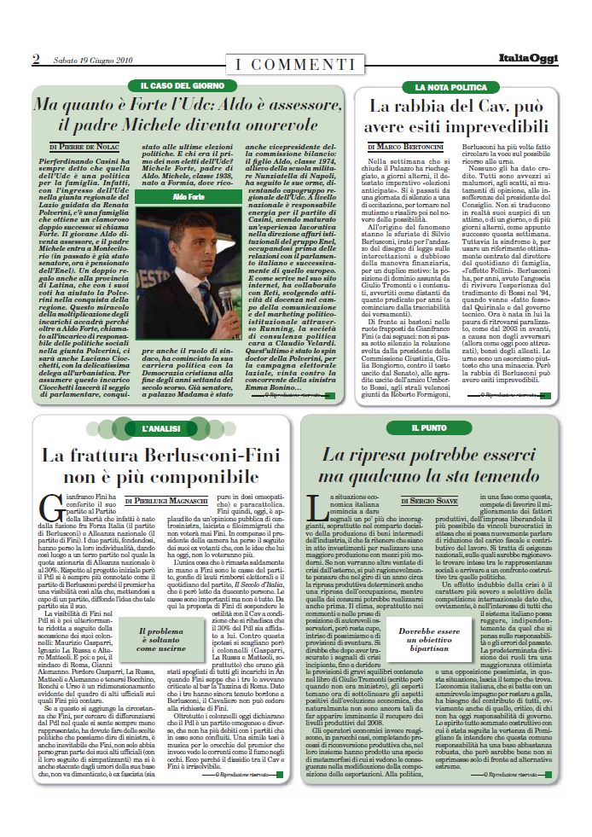
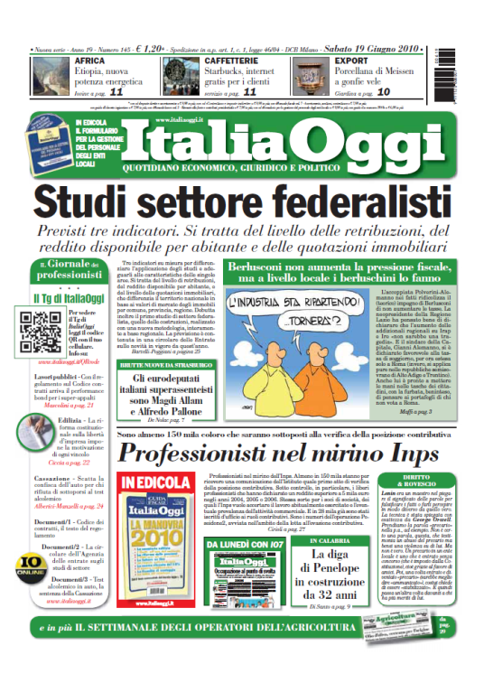
ItaliaOggi
SHORT APP DESCRIPTION
NEWS CATEGORIES & CONTENT
Improve the way you connect to economic, legal and political news, with fast access to printable ItaliaOggi stories.
CATEGORY
CONTENT
Class News (Free)
Free 4 page PDF
(Monday – Friday)
LONG APP DESCRIPTION
PLACEHOLDER
ItaliaOggi makes it easy to quickly access and print economic, legal and political news. Simply use the touchscreen to get vital information related to the world of law practices, economics, communications, schools, construction, justice, public administration and agriculture.
Italia Oggi
(Premium)
30-40 page
PDF Package
(Tuesday – Saturday)
PLACEHOLDER
USER INTERFACE
COUNTRIES
Italia Oggi Sette
(Premium)
30-40 page
PDF Package
(Monday)
Select Apps
App Italia Oggi offers its premium full content to users with active Italia Oggie subscriptions and free contents to all users.
News
Language(s): Italian

Slide 12


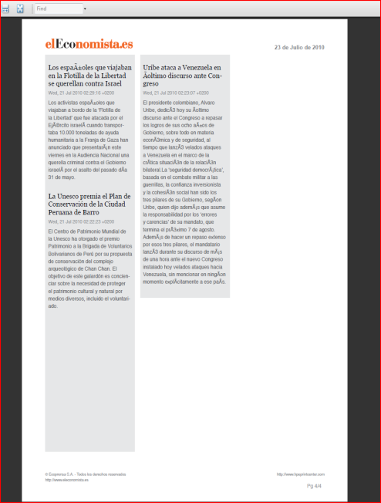
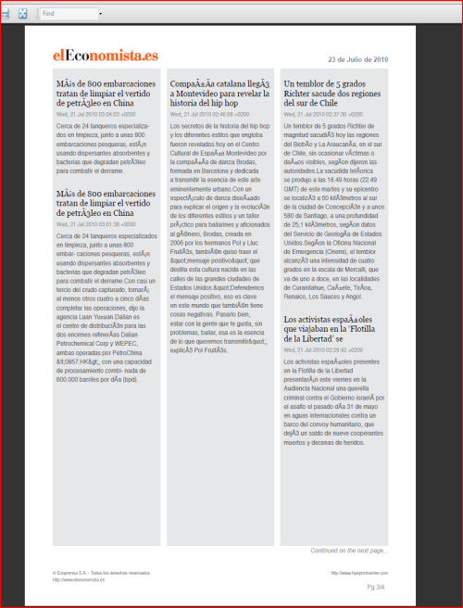
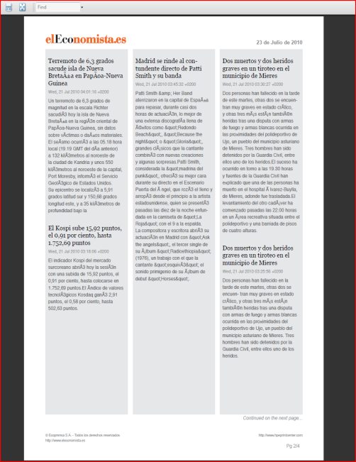
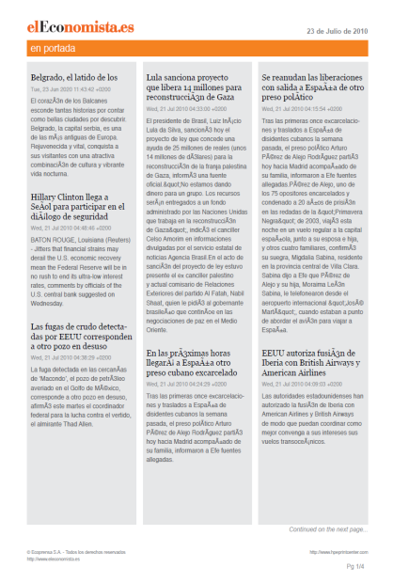
el Economista
SHORT APP DESCRIPTION
NEWS STRUCTURE
Keep close to vital financial news and market analysis – simply connect to el Economista and print.
CONTENT
LONG APP DESCRIPTION
App el Economista offers its premium full content to users with active el Economista subscriptions. The premium content is delivered in PDF format to the HP server and is refreshed real time. All contents are pre-formatted by el Economista.
el Economista provides a quick link to financial news and market analysis. Easily print articles and information using the touchscreen, and stay up-to-date on the financial industry and other business news.
USER INTERFACE
COUNTRIES
Select Apps
News
Language(s): Spanish

Slide 13



Financial Times
PLACEHOLDER
SHORT APP DESCRIPTION
NEWS CATEGORIES & CONTENT
Take advantage of the expertise of the Financial Times – industry headlines delivered directly from your printer.
CATEGORY
World Main
Americas society
LONG APP DESCRIPTION
Global Economy
Canada
Africa
UK
With quick access to headlines from the Financial Times, you can stay connected to the latest news and analysis that matters most to you and your industry. Simply use the touchscreen to print headlines in a snap.
Asia-Pacific
UK business
PLACEHOLDER
Europe
UK economy
Middle East
UK politics
USER INTERFACE
COUNTRIES
Americas
UK society
Americas business
US
PLACEHOLDER
Americas economy
US economy
Americas finance
US politics
Select Apps
Americas politics
US society
Americas regulation & reform
News
CONTENT
Language(s): English
All summaries from the last available date. App Financial Times offers free contents to all users.

Slide 14
DAILY BRIEF

Slide 15


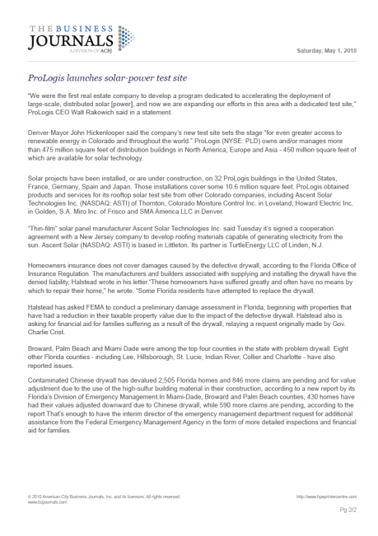
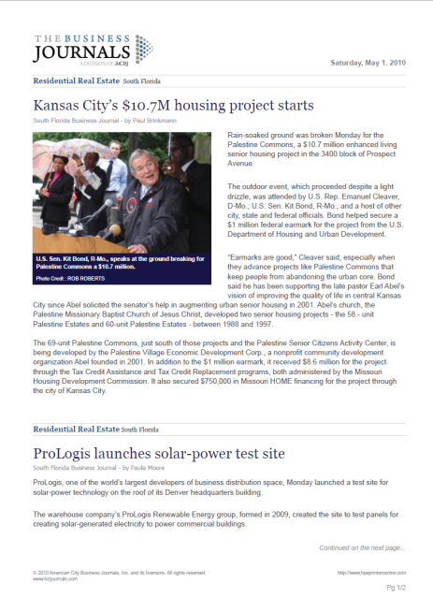
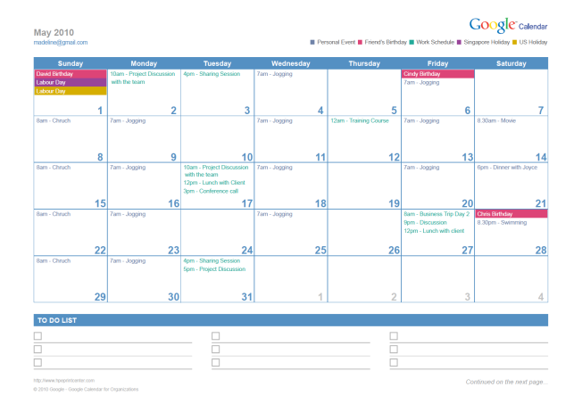
Google Calendar +
American City Business Journals
SHORT APP DESCRIPTION
DAILY BRIEF STRUCTURE
Find and print specific business community news, along with your Google™ Calendar and to-do list.
CALENDAR STRUCTURE
3 Calendar Views:
Today, This Week & This Month
NEWS STRUCTURE
LONG APP DESCRIPTION
Free news Briefs offered by American City Business Journals are categorized by News Category and News Location.
Through Google™ Calendar and American City Business Journals, Daily Brief gives you access to the news items that affect your industry. You can print it, along with your Google™ Calendar and to-do-list, all from one location.
NEWS CATEGORY
Local News Brief*
Insurance
U.S. Business News**
Legal Services
Accounting & Consulting
Logistics &
Transportation
Agriculture
Manufacturing
USER INTERFACE
COUNTRIES
Banking & Financial Services
Media & Marketing
Economic Snapshot & Bankruptcies
Real Estate
Education
Retailing & Restaurants
Select Apps
Energy, the Environment and Green
Sports
Health Care
Technology
Human Resources
Travel Industry
Daily Brief
* Only available for ACBJ supported cities
** U.S. Business News is a news category leveraging on Portfolio TODAY, and email product currently available on bizjournals.com
Language(s): English
NEWS LOCATIONS
See “News Locations” Table on following page

Slide 16
Google Calendar +
American City Business Journals, continued
Free news Briefs offered by American City Business Journals are categorized by News Category and News Location.
NEWS STRUCTURE - CATEGORY
NEWS LOCATION
NEWS CATEGORY
AVAILABLE NEWS LOCATIONS
Local News Brief*
Insurance
Albany
Dallas
Milwaukee
San Francisco
U.S. Business News**
Legal Services
Albuquerque
Dayton
Minneapolis/St. Paul
San Jose
Accounting & Consulting
Logistics &
Transportation
Atlanta
Denver
Nashville
Seattle
Agriculture
Manufacturing
Austin
Greensboro
Orlando
South Florida
Banking & Financial Services
Media & Marketing
Baltimore
Honolulu
Pittsburgh
St. Louis
Economic Snapshot & Bankruptcies
Real Estate
Education
Retailing & Restaurants
Birmingham
Houston
Philadelphia
Tampa Bay
Energy, the Environment and Green
Sports
Boston
Jacksonville
Phoenix
Washington DC
Health Care
Technology
Buffalo
Kansas City
Portland
Wichita
Human Resources
Travel Industry
Charlotte
Los Angeles
Raleigh/ Durham
**Not Listed
* Only available for ACBJ supported cities
** U.S. Business News is a news category leveraging on Portfolio TODAY, and email product currently available on bizjournals.com
Cincinnati
Louisville
Sacramento
** For users whose locations are not supported, only 19 news categories will be offered.
NEWS LOCATIONS
Columbus
Memphis
San Antonio
See “News Locations” in the adjacent table

Slide 17
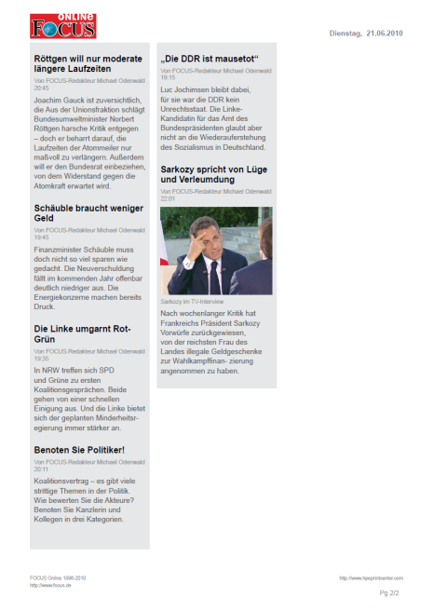
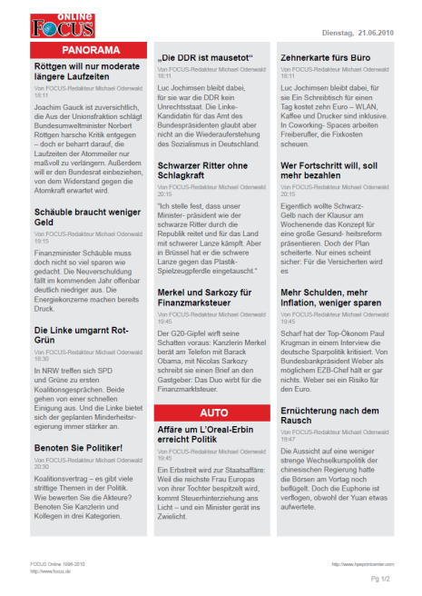
Google Calendar +
FOCUS Online
SHORT APP DESCRIPTION
DAILY BRIEF STRUCTURE
Collect and print industry news – banking, energy, healthcare and more – along with schedules and to-do lists.
CALENDAR STRUCTURE
3 Calendar Views:
Today, This Week & This Month
LONG APP DESCRIPTION
NEWS STRUCTURE
Through Google™ Calendar and FOCUS Online, Daily Brief delivers news and analysis from a variety of industries – banking, energy, healthcare and more. Print vital information – and your schedules and to-do-lists – all from one location.
NEWS CATEGORY
CONTENT FORMAT
Banken
Free news digests offered. Brief articles only. Contents from the latest date will be printed. Up to 25 brief articles per category.
Gesundheit
Energiesparen
USER INTERFACE
COUNTRIES
Immobilien
Bauen
Auto
Select Apps
Versichergen
Reisen
Daily Brief
Finanzen
Free news digests offered by FOCUS Online.
Germany’s Daily Brief offers up to 25 brief articles in 9 different industry categories.
Language(s): German

Slide 18

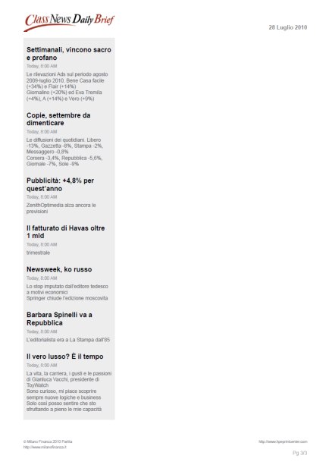
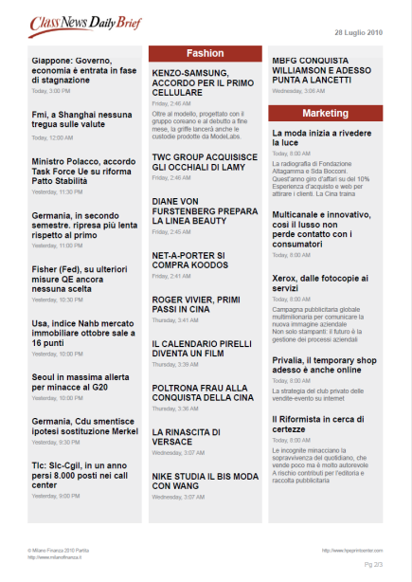
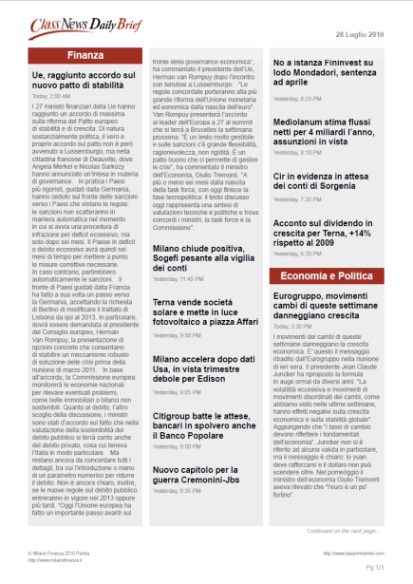
Google Calendar +
Class News
SHORT APP DESCRIPTION
DAILY BRIEF STRUCTURE
Collect and print financial and business news from Class Editori, along with your schedules and to-do lists.
CALENDAR STRUCTURE
3 Calendar Views:
Today, This Week & This Month
LONG APP DESCRIPTION
NEWS STRUCTURE
Through Google™ Calendar and Class News, Daily Brief delivers access to news from finance, economics, marketing, fashion and more. Print vital information – and your schedules and to-do lists – all from one location.
NEWS CATEGORY
CONTENT FORMAT
Finanza
All summaries from the last available date.
Economia e Politica
USER INTERFACE
COUNTRIES
Fashion
Select Apps
Marketing
Daily Brief
Free news digests offered by Milano Finanza.
Italy’s Daily Brief offers news digests in 4
different categories.
Language(s): Italian

Slide 19

Google Calendar +
El Economista
SHORT APP DESCRIPTION
DAILY BRIEF STRUCTURE
Print financial news and market analysis from el Economista, along with your schedules and to-do lists.
CALENDAR STRUCTURE
3 Calendar Views:
Today, This Week & This Month
LONG APP DESCRIPTION
NEWS STRUCTURE
Through Google™ Calendar and el Economista, Daily Brief delivers access to news and analysis that affects the financial industry. Print vital business information, along with your schedules and to-do lists, all from one location.
NEWS CATEGORY
en portada
Bolsas y mercados
El Flash del mercado
Actualidad
global
Empresas
Internacional
USER INTERFACE
COUNTRIES
Economía
Tecnología
Gestión empresarial
Motor
Select Apps
CONTENT FORMAT
Each category: 20 summaries
Daily Brief
Free news digests offered by el Economista.
Spain's Daily Brief offers short paragraphs in 10 different industry categories.
Language(s): Spanish

Slide 20

Google Calendar +
Reuters
SHORT APP DESCRIPTION
DAILY BRIEF STRUCTURE
Print headline s and news summaries from Reuters along with your schedules and to-do lists.
CALENDAR STRUCTURE
3 Calendar Views:
Today, This Week & This Month
LONG APP DESCRIPTION
NEWS STRUCTURE
Through Google™ Calendar and Reuters, Daily Brief delivers access to the latest headlines. Print information that’s important to you – plus your schedules and to-do lists – all from one location.
NEWS CATEGORY
Top News
Internet
Business
Science
Domestic
Lifestyle
USER INTERFACE
COUNTRIES
Technology
Markets
Health
Companies
Select Apps
CONTENT FORMAT
Each category: 5 summaries
Daily Brief
Free news digests offered by Reuters.
UK’s Daily Brief offers short paragraphs in 10 different industry categories.
Language(s): English

Slide 21
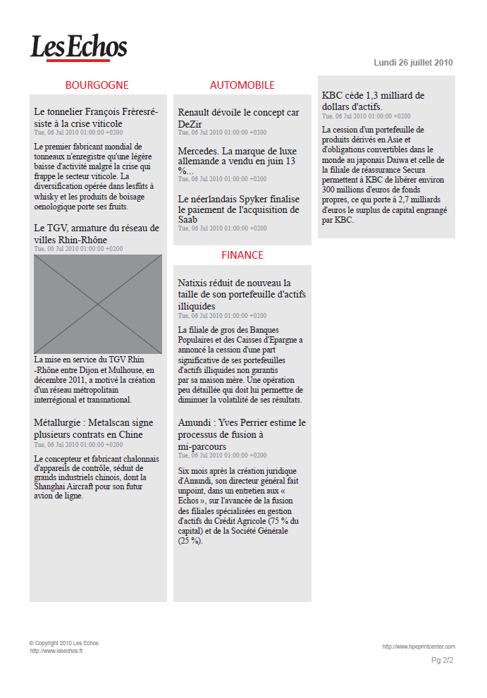
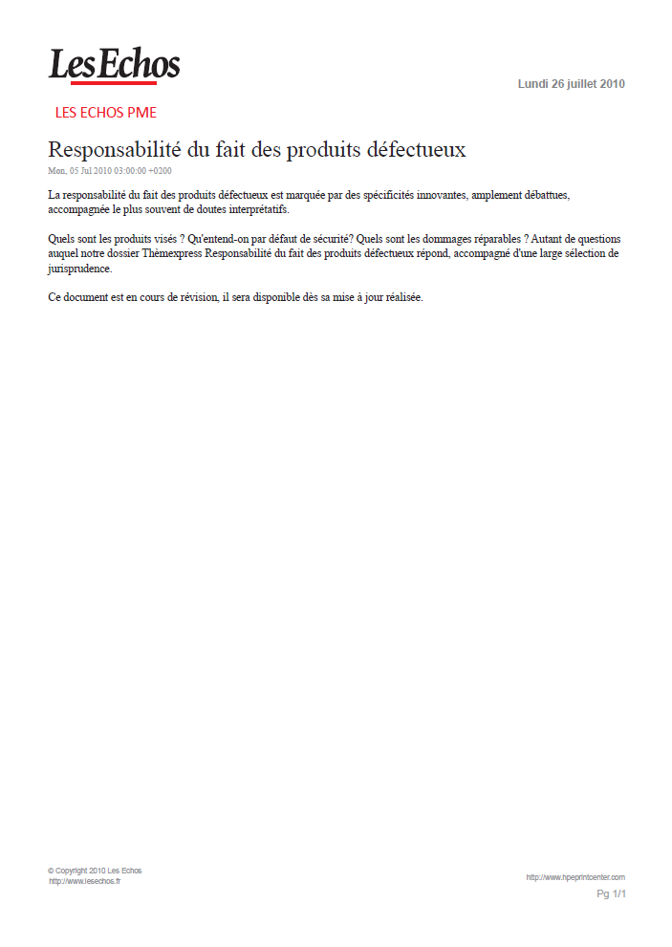
Google Calendar +
Les Echos
SHORT APP DESCRIPTION
DAILY BRIEF STRUCTURE
Access and print business and financial news articles from Les Echos, along with your schedules and to-do lists.
CALENDAR STRUCTURE
LONG APP DESCRIPTION
3 Calendar Views:
Today, This Week & This Month
Through Google™ Calendar and Les Echos, Daily Brief delivers access to business news and analysis that affects the financial industry. Print vital business information, along with your schedules and to-do lists, all from one location.
NEWS STRUCTURE
MANDATORY NEWS CATEGORY
OPTIONAL NEWS CATEGORY
USER INTERFACE
COUNTRIES
Free news digests offered by Les Echos are categorized by News Location and News Category. France Daily Brief offers short paragraphs in 16 different industry categories and 23 different French locations.
(see table on the following page)
Select Apps
Daily Brief
Language(s): French

Slide 22
Google Calendar +
Les Echos, continued…
STRUCTURE
MANDATORY NEWS CONTENT
CONTENT FORMAT
Les Echos PME
All full story of the day
OPTIONAL NEWS CONTENT
CONTENT FORMAT
23 LOCAL NEWS LOCATIONS
Local News*
Three most recent headlines, subtitles and one-sentence summary
Alsace
Île de France
23 locations
(see adjacent table)
Aquitaine
Limousin
Aéronautiques et défense
Auvergne
Lorraine
Agroalimentaire
Basse-Normandie
Midi-Pyrénées
Automobile
Bourgogne
Nord-Pas-de-Calais
Communication
Bretagne
Pays de la Loire
Biens de consommation
Centre
Picardie
Distribution
Champagne-Ardenne
Poitou-Charentes
Energie et environnement
Corse
PACA
Biens d’équipement
Franche-Comté
Rhône-Alpes
Finance
Hightech
Haute-Normandie
DOM-TOM
Industries de base
Languedoc-Roussillon
Marchés
CONTENT FORMAT for LOCAL NEWS LOCATIONS
Santé
Services
Three most recent headlines, subtitles and one-sentence summary
Transport

Slide 23


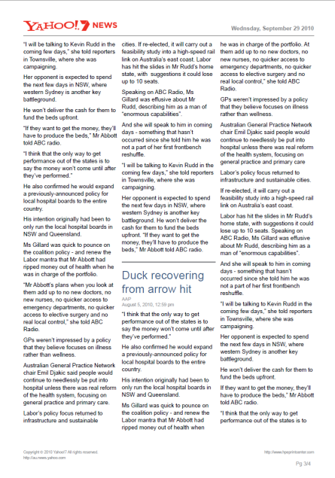

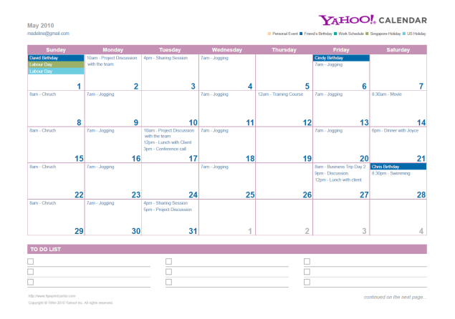

Yahoo! Calendar +
Yahoo!7
SHORT APP DESCRIPTION
DAILY BRIEF STRUCTURE
Get headline news formatted for print from around the world, and easily print schedules from your Yahoo! Calendar.
CALENDAR STRUCTURE
3 Calendar Views:
Today, This Week & This Month
NEWS STRUCTURE
LONG APP DESCRIPTION
Free news Briefs offered by Yahoo! are categorized by News Category and News Location.
With fast access to Yahoo!7 and Yahoo! Calendar through Daily Brief, you can quickly and easily get the information you want directly from your printer – regional and industry news and headlines that are customizable, plus the ability to print integrates schedules in one job.
NEWS CATEGORY
Basic Materials
Industrial
Goods
Conglomerates
Services
Consumer Goods
Technology
USER INTERFACE
COUNTRIES
Financial
Utilities
Healthcare
Select Apps
CONTENT
Each category:
5 full stories + 10 short summaries
Daily Brief
NEWS LOCATIONS
Language(s): English
NSW, QLD, VIC, WA, SA, TAS, ACT, NY

Slide 24
Yahoo! Calendar +
Yahoo!Xtra
SHORT APP DESCRIPTION
DAILY BRIEF STRUCTURE
Collect and print regional and industry news articles, along with schedules from your Yahoo! Calendar.
CALENDAR STRUCTURE
3 Calendar Views:
Today, This Week & This Month
NEWS STRUCTURE
LONG APP DESCRIPTION
Free news Briefs offered by Yahoo! are categorized by News Category and News Location.
With fast access to Yahoo!Xtra and Yahoo! Calendar through Daily Brief, you can get the information you want directly from your printer – regional and industry news and headlines that are customizable, plus the ability to print integrated schedules in one job.
NEWS CATEGORY
Basic Materials
Industrial
Goods
Conglomerates
Services
Consumer Goods
Technology
USER INTERFACE
COUNTRIES
Financial
Utilities
Healthcare
Select Apps
CONTENT
Each category:
5 full stories + 10 short summaries
Daily Brief
NEWS LOCATIONS
Language(s): English
Auckland, Canterbury, Gisborne, Hawkes Bay, Manawatu, Marlborough, Nelson, Northland, Otago, Southland, Taranki, Waikato, Wellington, Westland

Slide 25
FORMS

Slide 26
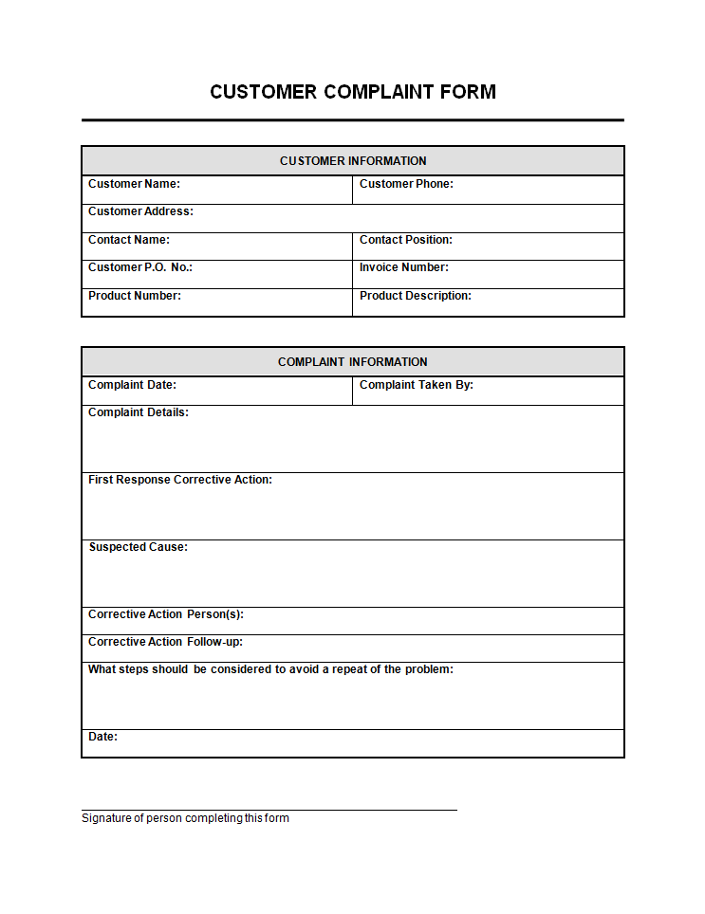
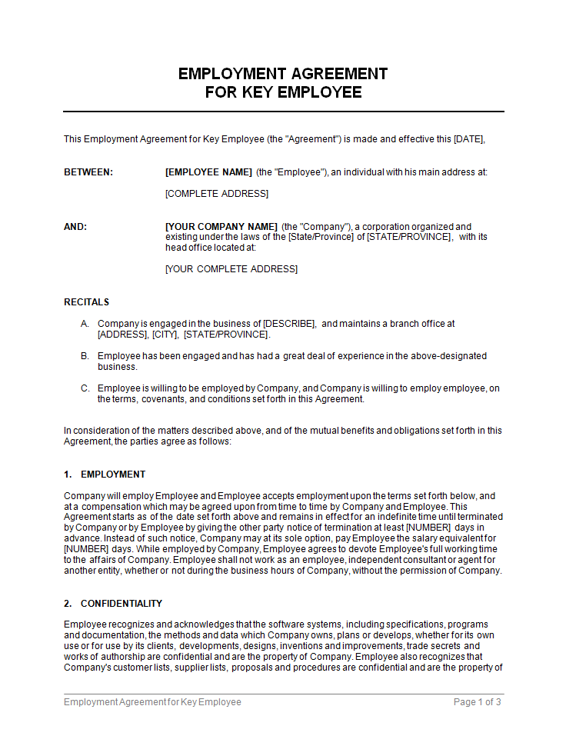
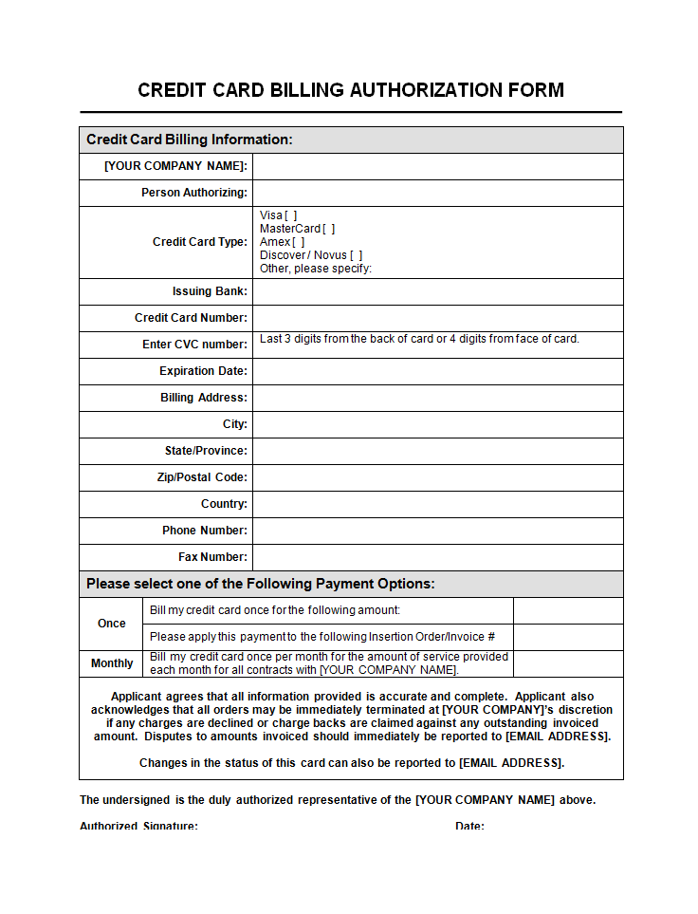
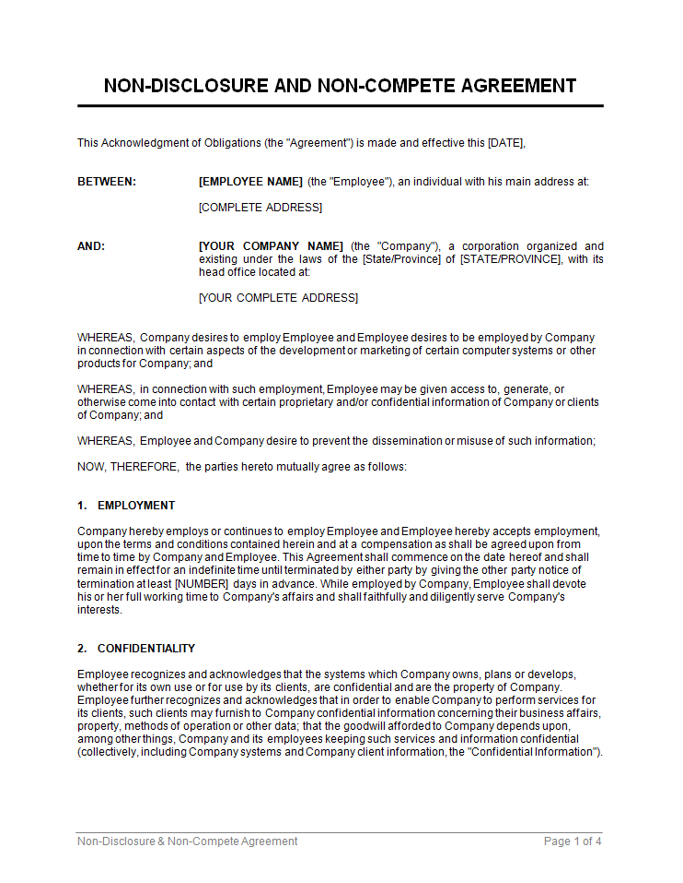
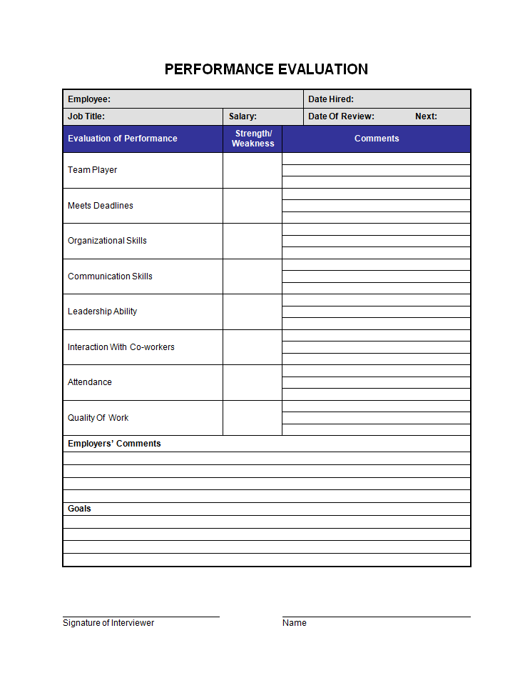
Biztree
SHORT APP DESCRIPTION
CATEGORIES
Access and print from an extensive library of document templates – contracts, legal agreements, letter and forms.
Free Docs
20 available forms
Doc Store
Catalog of available categories and top forms
(available to users logged in)
LONG APP DESCRIPTION
Connect to professional-quality documents for virtually any business need. Biztree gives you access to template directly from the touchscreen, so you can easily print contracts, legal agreements, letters, forms and checklists.
My Docs
Ability to get quick access to purchased or personal forms
(available to users logged in)
Biztree Coupon
About Biztree
USER INTERFACE
COUNTRIES
Select Apps
Forms
Language(s): EFIGS

Slide 27
Biztree, continued
“FREE DOCS” DOCUMENTS
“DOC STORE” MAIN CATEGORIES AND SUB-CATEGORIES (max 8 + Other)
Document Name
Format
Editing Required
Planning & Management
Legal
Credit card billing information form
Word
Yes
Board of Directors and Shareholders
Business Plans
General Administration
Starting a Business
Strategic Management
Agreements & Contracts
Asset Purchase Agreements
Confidentiality Agreements
Copyright, Patent & Trademark
Incorporation
License Agreements
Power of Attorney
Release
Other Docs
Employee emergency notification form
Word
Yes
Purchase Order
Word
Yes
Sales Invoice
Word
Yes
Wire transfer instruction form
Word
Yes
Consultants & Contractors
Applicant appraisal form
Word
No
Credit & Collections
Operations & Logistics
Business credit application
Word
No
Ordering & Receiving
Selling & Shipping
Vehicles & Equipment
Check request form
Excel
No
Collection
Credit
Consumer credit application
Word
No
Finance & Accounting
Credit memo
Word
No
Real Estate
Consumer complain form
Word
No
Banking
Bookkeeping
Buying & Selling Shares
Financial Statements
Invoices and Billing
Loans & Borrowing
Payments to Creditors
Raising Capital
Other Docs
Direct deposit enrollment form
Word
No
Assignments
Contracts, Agreements & Checklists
Evictions
Notices
Employee Appraisal form
Word
No
Employee correction form
Word
No
Employee application form
Word
No
Human Resources
Sales & Marketing
Exit interview form
Word
No
Compensation & Benefits
Employee Reference Letter
Firing & Termination
Hiring Employees
Insurance
Managing & Motivating Employees
Policies & Documentation
Expense statement
Excel
No
Agreements & Contracts
Bids and Proposals
Customer Service
Market Analysis
Marketing Planning
Press and PR
Purchase Orders & Price Quotes
Sales Letters
Other Docs
Management audit
Word
No
Office supplies request
Excel
No
Phone memo
Word
No
Internet & Technology
Receipt for goods and services
Word
No
Self evaluation form
Word
No
Advertising & Marketing
Content & Copyright Agreements
Hosting Agreements
IT Support & Maintenance
Software
Web Development
Website Notices & Checklists
Time sheet
Excel
No
Vehicle mileage log
Excel
No
Worksheet termination of employment
Word
No

Slide 28


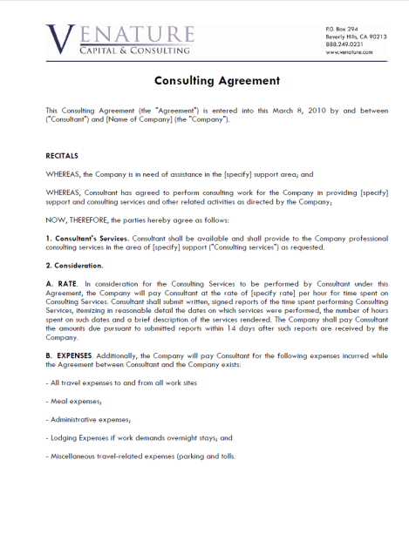
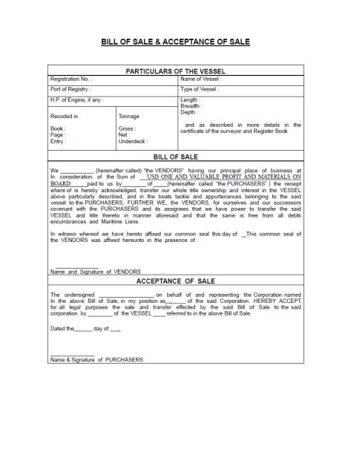
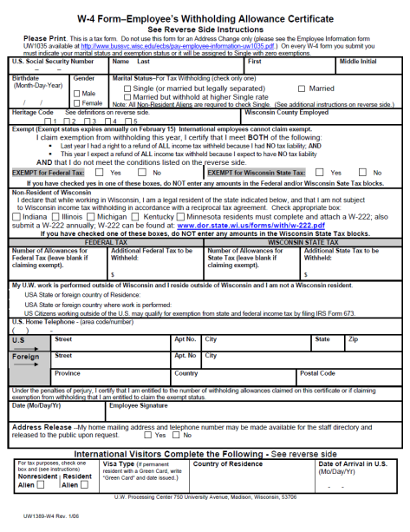
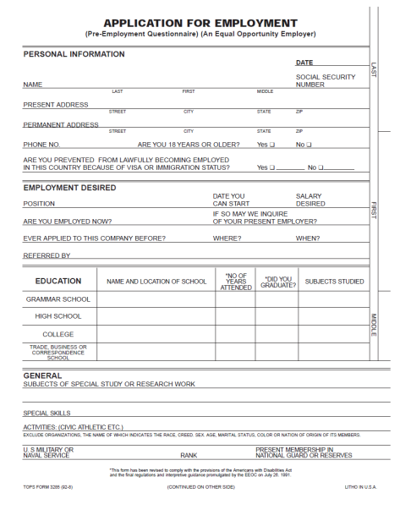
DocStoc
SHORT APP DESCRIPTION
CATEGORIES
Get one-touch access to commonly used business forms, such as invoices, contracts, receipts and more.
CATEGORIES UNDER “MY DOCS”
(only displayed for login users)
My Documents
LONG APP DESCRIPTION
Downloaded
My Purchases
Find and share the templates you need with DocStoc, the premier online community for professional documents. Gain access directly from the touchscreen for legal, business, financial, technical and educational documents.
Uploaded
Fulfilled Requests
CATEGORIES
Entrepreneurship
Business Management and Operations
USER INTERFACE
COUNTRIES
Running a Business
Human Resources
Finance and Accounting
Buying and Selling a Business
Select Apps
Legal Contracts
Internet and Technology
Marketing and Sales
Consultants and Contractors
Forms
CONTENT
Language(s): English
EACH CATEGORY: 10 documents for non-login users, 20 more locked documents for login users

Slide 29






FORMBLITZ
SHORT APP DESCRIPTION
CATEGORIES
Find legal and business documents at your fingertips – contracts, forms and more from FORMBLITZ.
Top Forms
20 available forms (most popular business and tax forms)
LONG APP DESCRIPTION
Get access to FORMBLITZ to easily print legal and business documents. Simply use the touchscreen to produce contracts, credit and loan agreements, cover letters, resumes and man more forms – even sample documents.
My Library
Catalogue of 1,000 templates available per category accessible upon subscription
USER INTERFACE
COUNTRIES
My Forms
10 latest purchased documents stored in the printer
Select Apps
FORMBLITZ
Language(s): German

Slide 30
FORMBLITZ, continued
TOP FORMS
MY LIBRARY
GERMAN
ENGLISH
Bϋro & Organisation (Office & Organization)
Ehe & Erbschaft (Marriage & Wills)
Quittung
receipt
Vorlagen & Formulare (Templates & Forms)
Verträge & Verfϋgungen (Contracts & Directions)
Musterbriefe (Sample Letters)
Checklisten (Checklists)
Kurzratgeber (Short Guides)
Songstiges (Other)
Vorlagen & Formulare (Templates & Forms)
Verträge & Verfϋgungen (Contracts & Directions)
Musterbriefe (Sample Letters)
Checklisten (Checklists)
Kurzratgeber (Short Guides)
Songstiges (Other)
Rechnung
bill
Gesprächsnotiz
memo
Fahrtenbuch
driver’s logbook
Unternehmen & Finanzen (Business & Finance)
Familie & Freizeit (Family & Leisure)
Reisekostenabrechnung
travel expense report
Vorlagen & Formulare (Templates & Forms)
Verträge & Verfϋgungen (Contracts & Directions)
Musterbriefe (Sample Letters)
Checklisten (Checklists)
Kurzratgeber (Short Guides)
Songstiges (Other)
Vorlagen & Formulare (Templates & Forms)
Verträge & Verfϋgungen (Contracts & Directions)
Musterbriefe (Sample Letters)
Checklisten (Checklists)
Kurzratgeber (Short Guides)
Songstiges (Other)
Bewirtungsbeleg
meal documentation
Vollmacht
power of attorney
EU-Überweisung
bank transfer (European standard)
Arbeit & Karriere (Work & Career)
Gesundheit & Vorsorge (Health & Provision)
Auftragsbuch
order form
Vorlagen & Formulare (Templates & Forms)
Verträge & Verfϋgungen (Contracts & Directions)
Musterbriefe (Sample Letters)
Checklisten (Checklists)
Kurzratgeber (Short Guides)
Songstiges (Other)
Vorlagen & Formulare (Templates & Forms)
Verträge & Verfϋgungen (Contracts & Directions)
Musterbriefe (Sample Letters)
Checklisten (Checklists)
Kurzratgeber (Short Guides)
Songstiges (Other)
Kostenvoranschlag
cost estimate
Bewerber-Fragebogen
applicant questionnaire
Besuchsbericht
visit report
Zielvereinbarung
target agreement
Haus & Wohnen (House & Living)
Steuer & Behörden (Tax & Government)
Vorlagen & Formulare (Templates & Forms)
Verträge & Verfϋgungen (Contracts & Directions)
Musterbriefe (Sample Letters)
Checklisten (Checklists)
Kurzratgeber (Short Guides)
Songstiges (Other)
Vorlagen & Formulare (Templates & Forms)
Verträge & Verfϋgungen (Contracts & Directions)
Musterbriefe (Sample Letters)
Checklisten (Checklists)
Kurzratgeber (Short Guides)
Songstiges (Other)
Zeitmanagement Checkliste
checklist for time management
SWOT-Analyse
SWOT-Analysis
Gewerbeanmeldung
business registration
Gewerbeabmeldung
business checkout
Auto Mobiles (Cars & Moving)
Vorlagen & Formulare (Templates & Forms)
Verträge & Verfϋgungen (Contracts & Directions)
Musterbriefe (Sample Letters)
Checklisten (Checklists)
Kurzratgeber (Short Guides)
Songstiges (Other)
Umsatzsteuervoranmeldung
turnover tax advance return
Einkommensteuererklärung
basic form income tax
Anlage N zur Einkommensteuererklärung
tax enclosure N for working people

Slide 31
EXPENSE
MANAGEMENT

Slide 32






QUICKBOOKS
SHORT APP DESCRIPTION
OPTIONS
Print reports from your QuickBooks account. Scan and attach expense receipts to your QuickBooks account entries. NOTE: TPS only offers “Print” not “Scan” until August ‘11.
Print Reports
Customers Who Owe Me
Account Balances
Profit and Loss
Sales Summary
Income Breakdown
Balance Sheet
Top Customers By Sales
LONG APP DESCRIPTION
With quick access to QuickBooks, print the most valuable reports such as company financials as well as reports to quickly identify who owes you money. Archive and record your expenses easier by attaching expense documents or scanned receipts to your QuickBooks account entries for accurate recording.
USER INTERFACE
COUNTRIES
Scan Receipts
Select Apps
QuickBooks
Language(s): English

Slide 33
CALENDARS

Slide 34




Google Calendar
SHORT APP DESCRIPTION
Print your Google™ Calendar to post and share – even daily, weekly or monthly views.
LONG APP DESCRIPTION
Use Google™ Calendar to log into and print schedules in a snap. With the versatility to produce daily, weekly and monthly print-outs of your calendar, you can stay on top of your schedule or easily share it with others.
USER INTERFACE
COUNTRIES
VIEWS
Select Apps
Today
This Week
This Month
To-Do Lists
Calendar
Language(s): EFIGS

Slide 35
COUPONS

Slide 36


beforeIshop
PLACEHOLDER
SHORT APP DESCRIPTION
COUPON CATEGORIES
pending
LONG APP DESCRIPTION
pending
USER INTERFACE
COUNTRIES
Select Apps
Coupons
Language(s): English

Slide 37
PRINT APPS

Slide 38





Print Apps
by definition…
Packaging
ePrintCenter
Description on an OJP 8500A eAiO package, North America
Front Panel of the UI
Quickly access the web using HP Apps – retrieve, print or store documents
“About Print Apps” Screen
“Home” Screen
Discover/Digital Office Section

Slide 39






























APPS – CATEGORIES
NEWS
DAILY BRIEF
BUSINESS FORMS
eSTORAGE
MARKETING MATERIALS
Selection of news and information to help you stay ahead of the game
Mash-up of updated, relevant information you need to keep your edge:
Local industry news, Calendar & To Do list
Instant access to standard business forms
Securely store documents to the web. Retrieve and print from anywhere!
Easily create customized marketing materials yourself
CLOUD

Slide 40


